Slide 1
Web Technologies
CSS

Slide 2
Summary of Today’s Lecture
CSS Introduction
CSS Rules
CSS Selectors
Simple Selectors
Pseudo-class Selectors
Attribute Selectors
Combinator Selectors
Inserting Style Sheet

Slide 3
CSS
CSS stands for cascading style sheets.
Cascading: refers to the procedure that determines which style will apply to a certain section, if you have more than one style rules.
Style: how you want certain part of your page to look like. You can set things like color, margins, fonts etc, for things like tables, paragraphs, headings etc.
Sheets: are like templates, or a set of rules, for determining how the webpage will look.
CSS is a stylesheet language used to describe the presentation of a document written in HTML.

Slide 4
CSS History
CSS was first proposed by Håkon Wium Lie on October 10, 1994. At the time, Lie was working with Tim Berners-Lee at CERN.
CSS1 was the first edition introduced in December 1996 an official W3C Recommendation. Håkon Wium Lie and Bert Bos are credited as the original developers.
CSS2 was published by W3C in 1998 and provides enhancement over CSS1.
CSS3 is the latest edition. The earliest CSS 3 drafts were published in June 1999 by W3C.
Several new functionalities have been provided through CSS3. Functions like flex box, rounded corners, background decoration, box shadows are introduced in this version.
There is no single, integrated CSS4 specification, because the specification has been split into many separate modules which level independently.
So far, five such "best current practices" documents have been published as Notes, in 2007, 2010, 2015, 2017, and 2018.

Slide 5
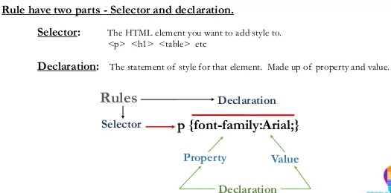
CSS Rules

Slide 6
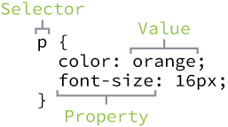
Selector
Selector
A selector designates exactly which element or elements within our HTML to target and apply styles to.
p { ... }

Slide 7
Property and Value
Property
A property determines the styles that will be applied to the element.
Property names fall after a selector, within the curly brackets, {}, and immediately preceding a colon, :.
There are numerous properties we can use, such as background, color, font-size, height, and width,
p { color: ...; font-size: ...; }
Value
Behavior of the property is determined with a value. Values can be identified as the text between the colon, :, and semicolon, ;.
p { color: orange; font-size: 16px; }

Slide 8
CSS Selectors
CSS selectors are used to "find" (or select) the HTML elements you want to style.
We can divide CSS selectors into five categories:
Simple selectors (select elements based on name, id, class)
Pseudo-class selectors (select elements based on a certain state)
Pseudo-elements selectors (select and style a part of an element)
Attribute selectors (select elements based on an attribute or attribute value)
Combinator selectors (select elements based on a specific relationship between them)

Slide 9
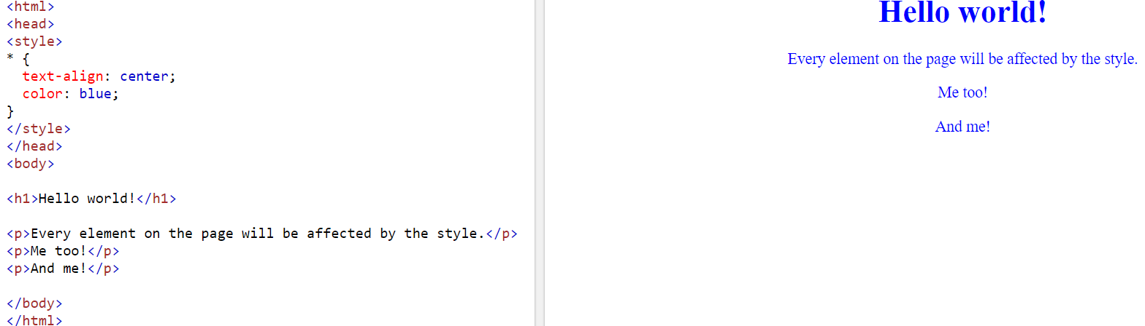
The CSS Universal Selector
The universal selector (*) selects all HTML elements on the page.
The CSS rule below will affect every HTML element on the page:

Slide 10
CSS element Selector
The element selector selects HTML elements based on the element name.
For example, if we want to target all division elements of type <div>, we will use element selector of div.
HTML
<div>...</div>
<p>...</p>
<div>...</div>
<p>...</p>
CSS
div { ... }

Slide 11
CSS class Selector
Class selectors allow us to select an element based on the element’s class attribute value.
Class selectors are a little more specific than type selectors, as they select a group of elements rather than all elements of one type.
Within CSS, classes are denoted by a leading period, ., followed by the class attribute value.
In the example below, the class selector will select any element containing the class attribute value of awesome, including both div and p elements.
HTML
<div class="awesome">...</div>
<p>...</p>
<div>...</div>
<p class="awesome">...</p>
CSS
.awesome { ... }

Slide 12
CSS id Selector
ID selectors are even more precise than class selectors, as they target only one unique element at a time.
ID selectors use an element’s id attribute value as a selector.
ID attribute values can only be used once per page.
Within CSS, ID selectors are denoted by a leading hash sign, #, followed by the id attribute value.
In the example below, ID selector will only select the element containing the id attribute value of shayhowe and para.
HTML
<div id="shayhowe">...</div>
<p>...</p>
<div>...</div>
<p id=“para">...</p>
CSS
#shayhowe { ... }
#para{ ... }

Slide 13
Inserting a Stylesheet
When a browser reads a style sheet, it will format the HTML document according to the information in the style sheet.
There are three ways of inserting a style sheet:
Inline style
Internal style sheet
External style sheet

Slide 14
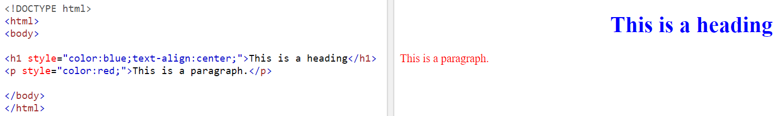
Inline Styles- the style Attribute
An inline style may be used to apply a unique style for a single element.
To use inline styles, add the style attribute to the relevant element. The style attribute can contain any CSS property.
An Inline style sheet loses many of the advantages of a style sheet. This is done by mixing content with presentation.
Used for one-time overrides and styling a particular element.
This is bad style and should be avoided when possible.

Slide 15
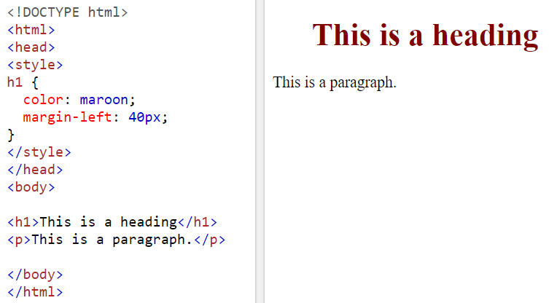
Internal Style Sheets
An internal style sheet may be used if one single HTML page has a unique style.
Internal styles are placed in the <head> section of an HTML page.
Internal styles are inserted inside the <style> tag.

Slide 16
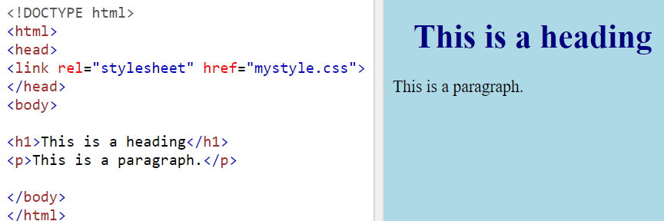
External Style sheet
An external style sheet is ideal when the style is applied to many pages.
With an external style sheet, you can change the look of an entire Web site by changing just one file.
Each page must include a link to the style sheet with the <link> tag.
An external style sheet can be written in any text editor and must be saved with a .css extension.
A page can link to multiple style sheet files.
In case of a conflict (two sheets define a style for the same HTML element), the later sheet's properties will be used.

Slide 17
Why CSS is called Cascading?
Multiple style sheets can be referenced inside the HTML document.
Which styles will be applicable when there is more than one style specified?
All styles cascade into a new virtual style sheet in this order (with lowest to highest priority in the sequence as described below):
Browser's default styles
External style sheet files (in a <link> tag)
Internal style sheets (inside a <style> tag in the page's header)
Inline style (the style attribute of the HTML element)

Slide 18
Why CSS is called Cascading?
In a single stylesheet, all styles cascade from the top of a style sheet to the bottom, allowing different styles to be added or overwritten as the style sheet progresses.
For example, we select all paragraph elements at the top of our style sheet and set their background color to orange and their font size to 24 pixels.
Then towards the bottom of our style sheet, we select all paragraph elements again and set their background color to green.
p {
background: orange;
font-size: 24px; }
p {
background: green;}
Because the paragraph selector that sets the background color to green comes after the paragraph selector that sets the background color to orange, it will take precedence in the cascade.
All of the paragraphs will appear with a green background.
The font size will remain 24 pixels because the second paragraph selector didn’t identify a new font size.

Slide 19
Selector Specificity (Example)
The higher the specificity weight of a selector, the more superiority the selector is given when a styling conflict occurs.
For example, if a paragraph element is selected using a type selector in one place and an ID selector in another, the ID selector will take precedence over the type selector regardless of where the ID selector appears in the cascade.
HTML
<p id="food">...</p>
CSS
#food { background: green; }
p { background: orange; }

Slide 20
Pseudo-class Selectors
Pseudo-classes are similar to regular classes in HTML however they are not directly stated within the HTML markup.
They are a dynamically populated as a result of user's actions or the document structure.
They are used to define a special state of an element. For example, it can be used to:
Style an element when a user moves mouse over it.
Style visited and unvisited links differently.
Style an element when it gets focus.
Syntax:
selector:pseudo-class { property: value; }
Types:
Link Pseudo-classes
User Action Pseudo-classes
User Interface State Pseudo-classes

Slide 21
Link Pseudo-classes
The :link and :visited pseudo-classes define if a link has or hasn’t been visited.
To style an anchor which has not been visited the :link pseudo-class is used.
The :visited pseudo-class styles links that a user has already visited based on their browsing history.
Syntax:
a:link {...}
a:visited {...}
Example:
/* unvisited link */ a:link { color: #FF0000; }
/* visited link */ a:visited { color: #00FF00; }

Slide 22
User Action Pseudo-classes
The :hover pseudo-class is applied to an element when a user moves their cursor over the element, most commonly used with anchor elements.
The :active pseudo-class is applied to an element when a user engages an element, such as clicking on an element.
Lastly, the :focus pseudo-class is applied to an element when a user has made an element the focus point of the page, often by using the keyboard to tab from one element to another.
Syntax
a:hover {...}
a:active {...}
a:focus {...}
Example
/* mouse over link */ a:hover { color: #FF00FF; }
/* selected link */ a:active { color: #0000FF; }

Slide 23
User Interface State Pseudo-classes
These user interface element state pseudo-classes include
:enabled,
:disabled,
:checked.
The :enabled pseudo-class selects an input that is in the default state of enabled and available for use.
:disabled pseudo-class selects an input that has the disabled attribute tied to it.
:checked represents the selected states of radio and checkbox elements.
Syntax:
input:enabled {...}
input:disabled {...}
Example:
input[type="text"]:enabled { background-color:red; }
input[type="text"]:disabled { background-color:blue; }
input:checked { border:1px solid pink;}

Slide 24
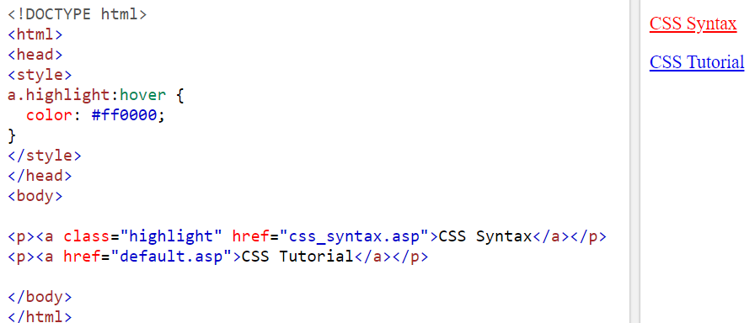
Pseudo-classes and CSS Classes
Pseudo-classes can be combined with CSS classes:
When you hover over the link in the example, it will change color:

Slide 25
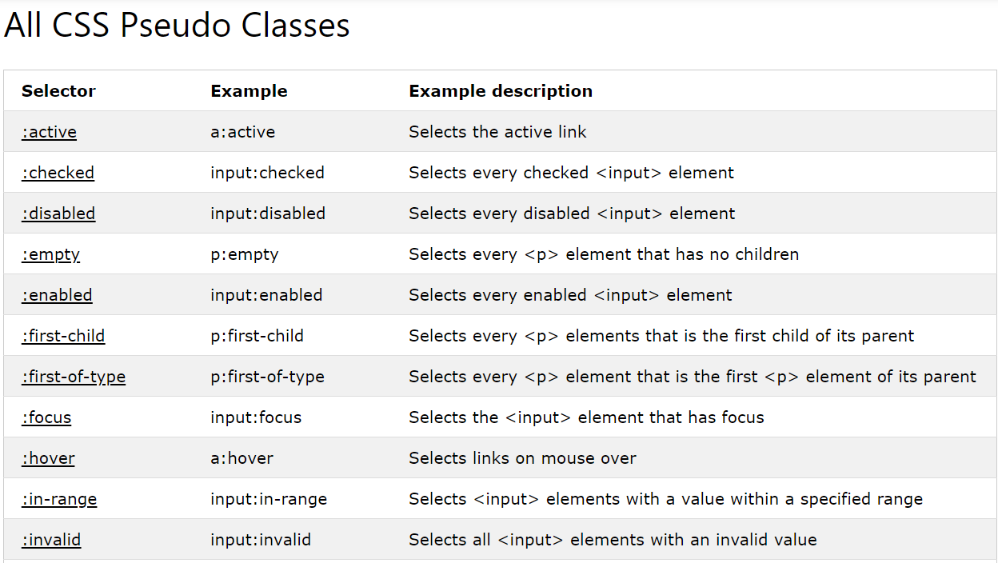
Miscellaneous Pseudo-classes

Slide 26
Attribute Selectors
It is possible to style HTML elements that have specific attributes or attribute values.
In CSS3, now elements can be selected based on whether an attribute is present and what its value may contain.
Following are the list of attribute selectors available in CSS.
Attribute Present Selector
Attribute Equals Selector
Attribute Contains Selector
Attribute Begins With Selector
Attribute Ends With Selector

Slide 27
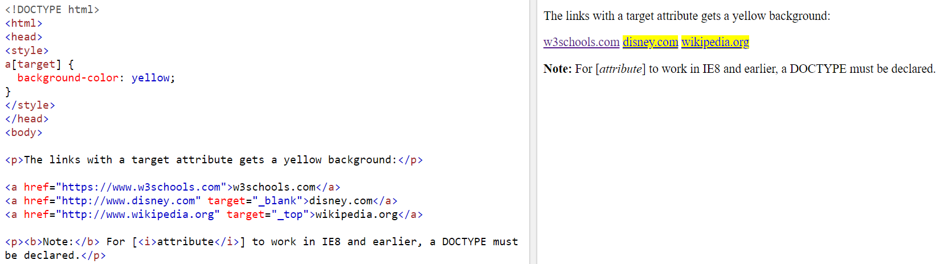
Attribute Present Selector
The first attribute selector identifies an element based on whether it includes an attribute or not, regardless of any actual value.
To select an element based on if an attribute is present or not simply include the attribute name in square brackets, [], within a selector.
The [attribute] selector is used to select elements with a specified attribute.
The following example selects all <a> elements with a target attribute:

Slide 28
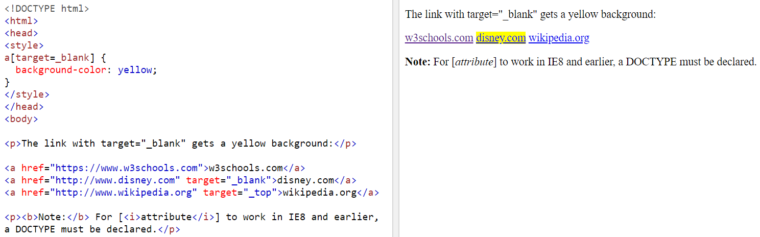
Attribute Equals Selector
To identify an element with a specific, and exact matching, attribute value the same selector from before may be used, however this time inside of the square brackets following the attribute name, include the desired matching value.
The [attribute="value"] selector is used to select elements with a specified attribute and value.
The following example selects all <a> elements with a target="_blank" attribute:

Slide 29
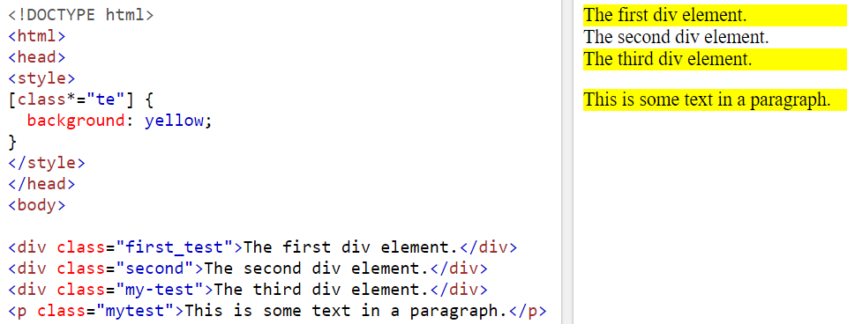
Attribute Contains Selector
When looking to find an element based on part of an attribute value, but not an exact match, the asterisk character, *, may be used within the square brackets of a selector.
The asterisk should fall just after the attribute name, directly before the equals sign.
The [attribute*="value"] selector is used to select elements whose attribute value contains a specified value.
The following example selects all elements with a class attribute value that contains "te":

Slide 30
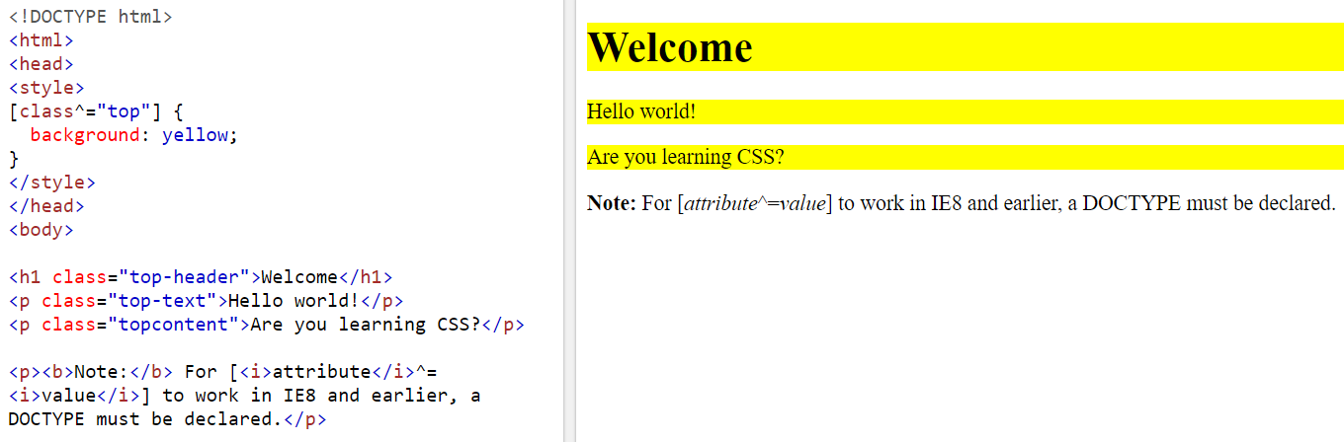
Attribute Begins With Selector
It is also possible to select an element based on what an attribute value begins with. Using a circumflex accent, ^, within the square brackets of a selector between the attribute name and equals sign denotes that the attribute value should begin with the stated value.
The [attribute^="value"] selector is used to select elements whose attribute value begins with a specified value.
The following example selects all elements with a class attribute value that begins with "top":

Slide 31

Attribute Ends With Selector
There is also an ends with attribute selector. Instead of using the circumflex accent, the ends with attribute selector uses the dollar sign, $, within the square brackets of a selector between the attribute name and equals sign. Using the dollar sign denotes that the attribute value needs to end with the stated value.
The [attribute$="value"] selector is used to select elements whose attribute value ends with a specified value.
The following example selects all elements with a class attribute value that ends with "test":

Slide 32
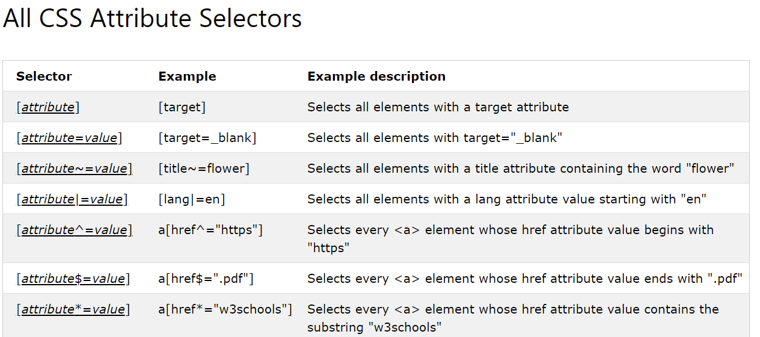
Attribute Selectors Overview

Slide 33
Combining Selectors
A CSS selector can contain more than one simple selector. Between the simple selectors, we can include a combinator.
A combinator is something that explains the relationship between the selectors.
By combining selectors we can be more specific about which element or group of elements we’d like to select.
Child Selectors
Sibling Selectors

Slide 34
Child Selectors
Child selectors provide a way to select elements that fall within one another, thus making them children of their parent element.
These selections can be made two different ways,
Descendant selector
Direct child selectors.

Slide 35
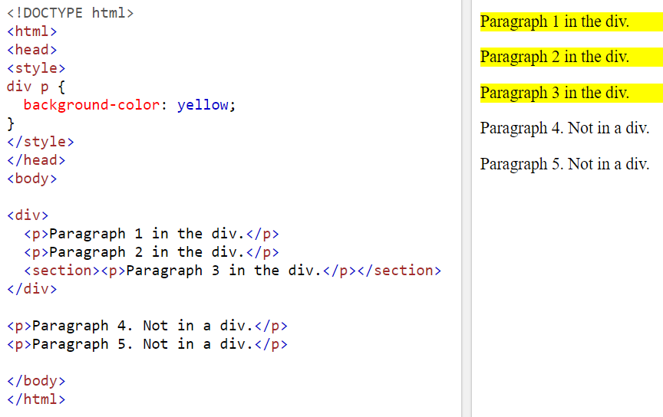
Descendant Selector
The descendant selector matches all elements that are descendants of a specified element.
Descendant selectors are created by spacing apart elements within a selector, creating a new level of hierarchy for each element list.
The following example selects all <p> elements inside <div> elements:

Slide 36
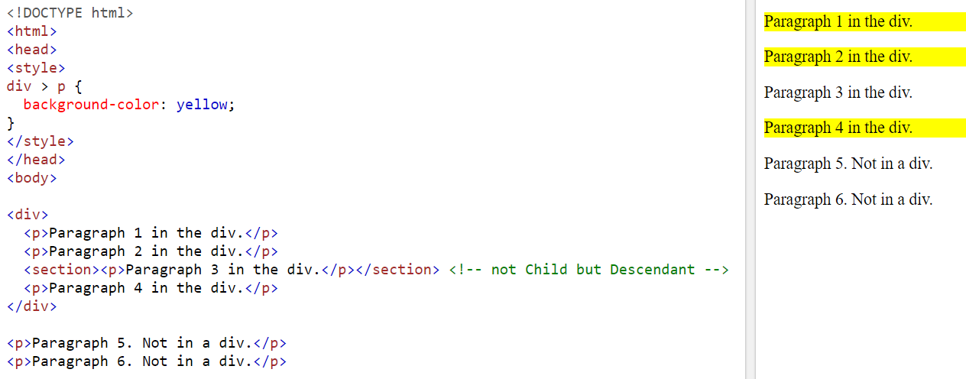
Direct Child Selector
The child selector selects all elements that are the children of a specified element.
The direct child selector may be used by placing a greater than sign, >, between the parent element and child element within the selector.
The following example selects all <p> elements that are children of a <div> element:

Slide 37
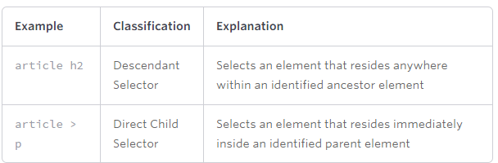
Child Selector Overview

Slide 38
Sibling Selectors
Sibling elements are those elements that share a common parent, may also need to be selected.
These sibling selections can be made by two ways
General sibling
Adjacent sibling selectors.

Slide 39
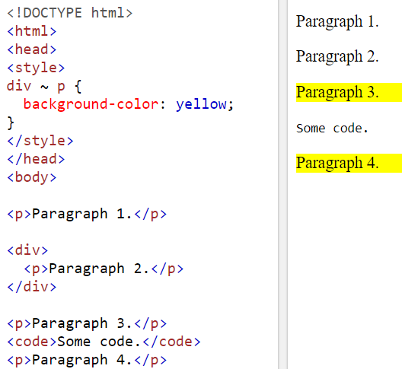
General Sibling Selector
The general sibling selector selects all elements that are siblings of a specified element.
They are created by using the tilde character, ~, between two elements within a selector. The first element identifies what the second element shall be a sibling with, and both of which must share the same parent.
The following example selects all <p> elements that are siblings of <div> elements:

Slide 40
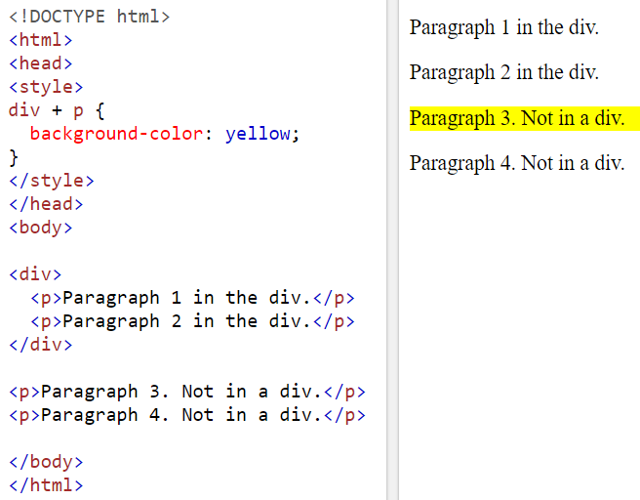
Adjacent Sibling Selector
The adjacent sibling selector selects all elements that are the adjacent siblings of a specified element.
Sibling elements must have the same parent element, and "adjacent" means "immediately following".
Adjacent sibling selector uses a plus character, +, between the two elements within a selector.
The following example selects all <p> elements that are placed immediately after <div> elements:

Slide 41
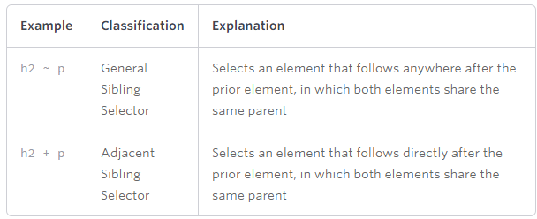
Sibling Selectors Overview

Slide 42
Summary of Today’s Lecture
CSS Introduction
CSS Rules
CSS Selectors
Simple Selectors
Pseudo-class Selectors
Pseudo-element Selectors
Attribute Selectors
Combinator Selectors
Inserting Style Sheet

Slide 43
Resources
The complete list of these selectors along with their description can be found at the following links:
https://www.w3.org/TR/css3-selectors/#checked
https://www.w3schools.com/css/css_pseudo_classes.asp
https://www.w3schools.com/cssref/css_selectors.asp
http://learn.shayhowe.com/advanced-html-css/complex-selectors/

